Slide 1



ML Training and Algorithms
PG Certificate in AI/ML and Data Engineering by IIT Roorkee

Slide 2
How algorithms work
Notes:
how algorithms work.

Slide 3
How algorithms work
Explore
Notes:
We will explore the important algorithms and

Slide 4
How algorithms work
Explore
Internal working
Notes:
their internal working in simple words using

Slide 5
How algorithms work
Explore
Internal working
Using real-life examples
Notes:
real-life examples without any maths or coding.

Slide 6
How algorithms work
Explore
Internal working
Using real-life examples
Concepts
Notes:
We will learn concepts like

Slide 7
How algorithms work
Explore
Internal working
Using real-life examples
Concepts
Linear Regression
Notes:
Linear Regression

Slide 8
Concepts Associated to Classification Algorithm Implementation
Gradient Descent
Batch Gradient Descent
Stochastic Gradient Descent
Mini Batch
Regularization

Slide 9
Regression Vs Classification
(a) Regression – We try to predict value of a continuous output variable or we try to obtain a function that maps input variables to some continuous valued output.
f(x) = 0.8 //continuous value
Given experience of an employee in years, predict salary
(b) Classification – We try to predict value of a discrete output variable or we try to obtain a function that maps input variables to some discrete categories.
f(x) = 0.8 , 0.8>threshold => discrete class //also read as probability of the class y given data x
Given a patient with a tumor, we have to predict whether the tumor is malignant or benign.

Slide 10



Data
Algorithm
Model
Notes:
In earlier chapters, we learnt that we feed the data feature matrix along with the expected output to the algorithm which generates the model.

Slide 11


Live Data
Data
Algorithm
Model
Prediction
Notes:
Then, this generated model can predict the output from the live data or the input for which we don't know the labels.

Slide 12
Live Data
Data
Algorithm
Model
Prediction
Notes:
But what is there in the algorithm that generates the model? And what does a model mean? Let's try to answer these questions.

Slide 13
Predicting salary based on the number of years of experience
Notes:
Let us take a really simple example of predicting the salary based on the number of years of experience.

Slide 14
2000
Notes:
Say, after the first year, your salary was 2000. And after the second year,

Slide 15
2000, 4000
Notes:
your salary became 4000,

Slide 16
2000, 4000, 6000
Notes:
and the third year 6000

Slide 17
2000, 4000, 6000, ______
Notes:
What will be your salary in the fourth year

Slide 18
2000, 4000, 6000, 8000
Other scenario: 3000, 5000, 7000,........
Notes:
That's right, it's 8000. You would have guessed there is linear relationship between salary and experience. Show the linear relationship on board.

Slide 19
Let's formulate the machine learning problem..
Historical Data
Years of Experience | Salary
1 | 2000
2 | 4000
3 | 6000
Notes:
Let us convert this problem into instances, features, and labels and see how to make the computers solve this problem.
In our case, there is one feature "years of experience". In real life, there could be multiple features such as the area of expertise, the location etc. And there is one target or label - Salary.

Slide 20
Let's formulate the machine learning problem..
Historical Data
Years of Experience | Salary
1 | 2000
2 | 4000
3 | 6000
Training
Model
Notes:
We would want to train a model

Slide 21
Let's formulate the machine learning problem..
Unknown Salary
Years of Experience | Salary
4 | ???
Historical Data
Years of Experience | Salary
1 | 2000
2 | 4000
3 | 6000
Training
Model
Notes:
such that the model can predict the salary for the fourth year.

Slide 22
Let's formulate the machine learning problem..
Unknown Salary
Years of Experience | Salary
4 | ???
Historical Data
Years of Experience | Salary
1 | 2000
2 | 4000
3 | 6000
Training
Model
Years of Experience | Salary
4 | 8000
Prediction
Notes:
Here, the model has predicted the salary for 4 years of experience as 8000.
Now, let us understand what goes into training it.

Slide 23
How would a computer do it? - plot it
6000
Salary
4000
2000
1
2
3
→ Years
Notes:
A simple way to solve it is to just plot it on a chart. The horizontal axis being years of experience, and vertical axis being the salary.

Slide 24
How would a computer do it? - plot it
6000
Salary
4000
2000
1
2
3
→ Years

Slide 25
How would a computer do it? - plot it
6000
Salary
4000
2000
1
2
3
→ Years

Slide 26
How would a computer do it? - plot it
6000
Salary
4000
2000
1
2
3
→ Years

Slide 27
How would a computer do it? - plot it
6000
Salary
4000
2000
1
2
3
→ Years
Notes:
And once we are done with plotting, ...

Slide 28
Ask the plot for the salary in 4th yr!
Respective Y value = 8000
6000
Salary
4000
2000
1
2
3
4
→ Years
Notes:
… we can figure out the salary for the 4th year ...

Slide 29
It is correct!
8000
6000
Salary
4000
2000
1
2
3
4
→ Years
Notes:
… which turns out to be 8000. Here we were lucky to have perfect data with which we could draw a straight line.

Slide 30
Life isn't perfect! You never get straight line!
6020
3980
2010
1
2
3
Notes:
What if our data was more like real-world data where we don't always get a perfect line? Say if the salaries for the three years were 2010, 3980, 6020? Can we draw a straight line that passes through all the points? No, we can't.
So, what do we do in this case? How do we figure out the salary for the fourth year?

Slide 31
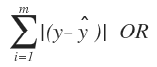
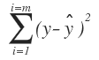
Linear Regression - Find best fitting line
P3
Line close to all the points -> MInimum prediction error for the given (training) data points.
= (2010-P1) + (3980-P2)+ (6020-P3)
Generalizing Error for m data points
Taking positive value of error
Cost=
6020
P2
3980
2010
P1
1
2
3
Notes:
The first strategy is to come up with a straight line that is closest to all the points. This approach is known as linear regression. Though, there are various other ways to do prediction which we will talk about later. For now, what could be the definition of the best fitting line? The best fitting line or line of best fit is a line which is closest to all the points. Meaning, it has minimum error. So, we could find the average of total deviations. And we can calculate the total deviation either by summing up the absolute differences or the squares of differences. And find a line which has the minimum error.

Slide 32
Normal Equation - Mathematically
Line 1
Each line is basically a function, which we call model in ML
6020
Line 2
3980
2010
Line 3
1
2
3
Notes:
Let us visualize the error. In this diagram, line 1 has the minimum error and hence it is the best line as compared to line 2 and 3.
So, our machine learning algorithm needs to come up with such a line which has the minimum error. Each line is basically a model. The model or line that algorithm comes up will be used for predictions.

Slide 33
Try multiple lines! Whichever is closer.
Line 1
6020
Line 2
3980
2010
Line 3
1
2
3
Notes:
We could create a simple algorithm that iterates over all possible lines and keeps the best line so far. Such an algorithm will basically try lines with all possible slopes and distances from the center.
What do you think is the challenge with this? It will take a huge amount of time to come up with the best model even in such a simple case.
Why not try to go to the side where the error is reducing?

Slide 34
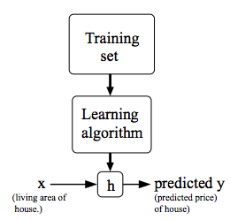
Linear Regression Model Representation
We need a model to fit the data.
It is a straight line that best fit the data
Notations:
m = Number of training examples,
X = input variable/ features,
y = output variable
(x^{i},y^{i}) = i^{th} training example
h : X → y so that h(x) is a good predictor for the corresponding value of y
// h is the decision function, the value given by h is decision score.
h_{θ}(x) = θ₀ + θ₁.x , //w₀ and w₁ decides the position of the line
(seperating line between two classes in case of classification) and (predictive line crossing the data points in case of regression)
Here θ₀ is intercept, which is value of y at x=0 and θ₁ is slope of the line.

Slide 35
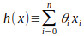
More Generic: Linear Regression Model Representation
h_{θ}(x) = θ₀ + θ₁x₁ + θ₂x₂ // Two features x₁ and x₂
h_{θ}(x) = θ₀ + θ₁x₁ + θ₂x₂+θ₃x₃+........ // n number of features x₁ and x₂ ............ x_{n}
In vector form:
h(x) = θ^{T}x // θ is the weight vector to be learned, and x is the vector of one training instance
h(x) = θ^{T}X // X is the feature matrix for the complete dataset (computing function for all instances), in the classification.ipynb file we are dealing with matrix/vector operations.
Notes:
Give h(x) example for the image classification problem (5 and not-5) with 784 features

Slide 36
Gradient Descent - Get the optimal slope of the line
6020
Initial Guess
3980
2010
1
2
3
4
Notes:
Say, we start with a random line with some slope and intercept.

Slide 37
Gradient Descent - find impact of slight change
6020
Try Increasing the slope a little bit
Initial Guess
3980
2010
1
2
3
4
Notes:
And then we try increasing the slope a little bit and observe the change in error due to the change in the slope. Here we have three instances 2010, 3980 and 6020. To compute the change in error we will have to check with all the instances.

Slide 38
Gradient Descent - guess next line!
Next line
6020
Try Increasing the slope a little bit
Initial Guess
3980
2010
1
2
3
4
Notes:
If the error is decreasing, we continue to increase slope at a faster pace.

Slide 39
How to get the best fit line? Manual Attempt
Our objective is to reduce the difference between actual output value and predicted value by h(x).
Error = h(x_{i})-y_{i} = 0 //or close to 0 for i^{th} training example
(x,y) = [(0,0), (1,1), (2,2), (3,3), (4,4)] //y=0 (bias term ‘b’ or ‘ θ₀’) at x=0, line will start from origin,
h(x) = θ₀+ θ₁*x //one feature only in the data
- Find out the linear equation for the given data points.
θ₀ =0 , θ₁ =0.5 //Initial guess
θ₀ =0 , θ₁ =1 // Best fit
=> h(x) = 0+1.x = x (zero error)
tanθ = 1 => θ = 45 degrees

Slide 40

Intuition of Gradient Descent
Question - If you are lost in the mountains in a dense fog and you can only feel the slope of the ground below your feet. Which strategy will you take to reach to the bottom of the valley quickly?
Your Current position
Bottom of the valley

Slide 41
Intuition of Gradient Descent
Answer
Take a step
If the step is downhill, keep walking on the same direction
Else reverse the direction
Repeat the steps until you reach to the bottom
Your Current position
Bottom of the valley

Slide 42
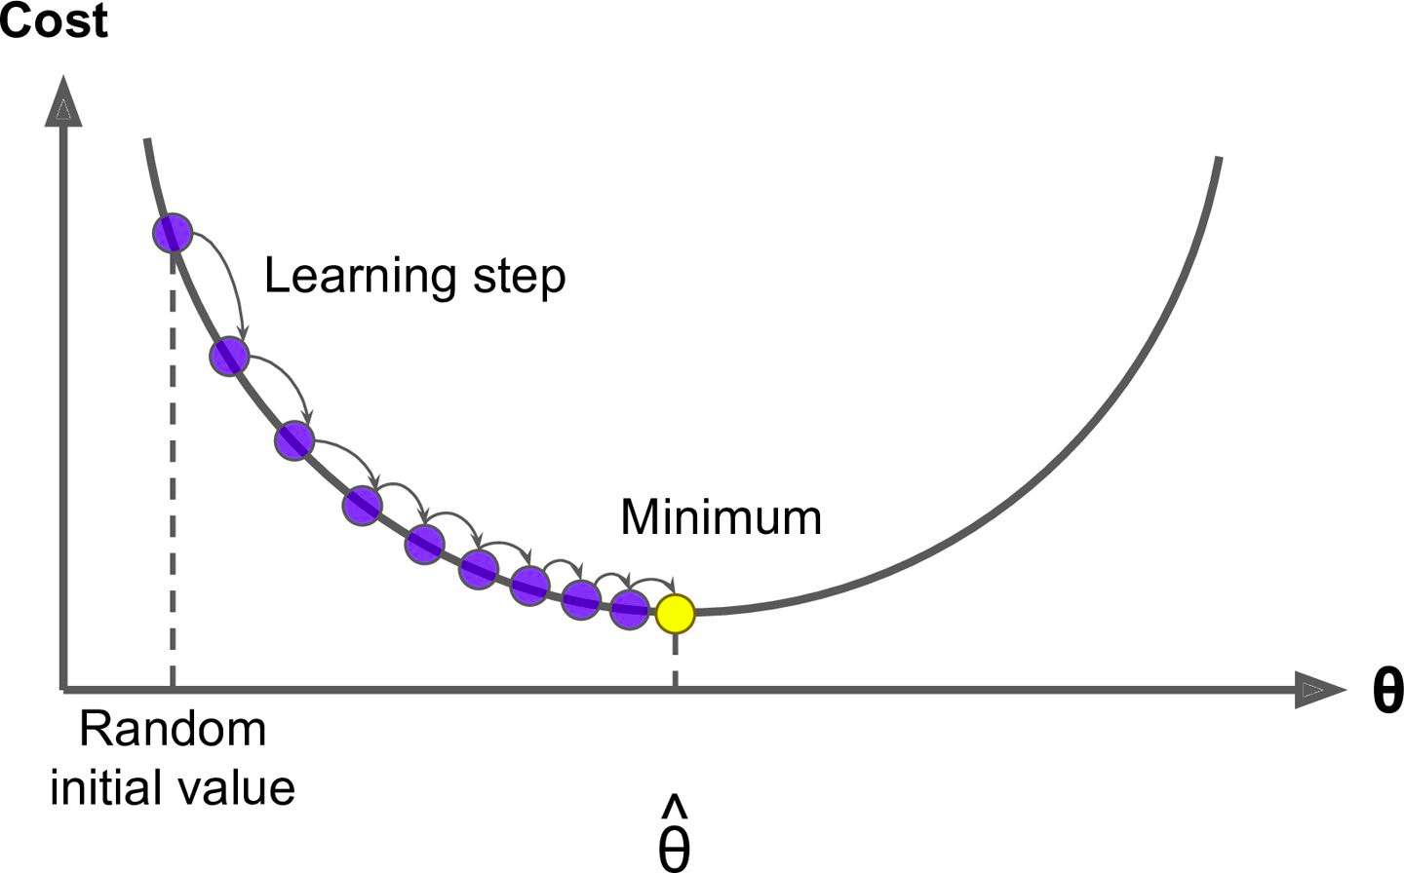
Gradient Descent

Slide 43
Gradient Descent
Gradient Descent
Measures the local gradient of the cost function
With regards to the parameter vector θ and
It goes in the direction of descending gradient
Until the gradient becomes zero

Slide 44
Gradient Descent
Random Initialization
We start by filling θ with random values - Random initialization
Improve it gradually, taking one baby step at a time
Each step attempts to decrease the cost function - MSE
Until the algorithm converges to a minimum

Slide 45
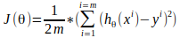
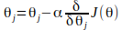
Gradient Descent: finding optimal θ
- Cost function J(θ) measures the accuracy of the hypothesis function. Objective is to minimize the cost function, that is, make h(x) close to y, at least for the training examples we have.
- Cost function (Mean Square Error (MSE)) is average difference between h(x) and y for all x and y.
J(θ)
Gradient Descent for one of the parameter θ_{j} for j^{th} feature:
Increase θ
Decrease θ
Notes:
Explain gradient descent with the help of graph.
If slope of the curve is positive, it means increasing with increasing theta value, hence perform subtraction of the partial derivative to existing theta.
If slope of the curve is negative, it means increasing with decreasing theta values, hene perorm addition of the partial derivative to existing theta

Slide 46
Finding best θ using Optimization Algorithm: Gradient Descent
Start with initial guesses
- Start at (θ = 0) (or any other value).
Keeping changing θ a little bit to reduce J(θ)
//Each time you change the parameters, you select the gradient (slope) which reduces J(θ) the most possible.
Repeat
Do so until you converge to a minimum.
Step-2 Formulation:
- Update θ by setting it to (θ - α times the partial derivative of the cost function with respect to θ)
- This update is simultaneously performed for all values of j = 0, . . . , n //number of features

Slide 47
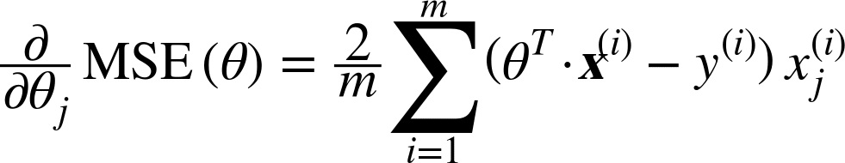
Partial Derivative of Cost Function
Partial Derivative of Cost Function
We compute the gradient of the cost function
With regards to each model parameter θj (Theta j)
Below is the equation for finding partial derivative of the cost function with respect to parameter θj (Theta j)

Slide 48
Gradient Descent
Learning Rate
In Gradient Descent
The size of the steps - also called as learning rate plays an important role

Slide 49
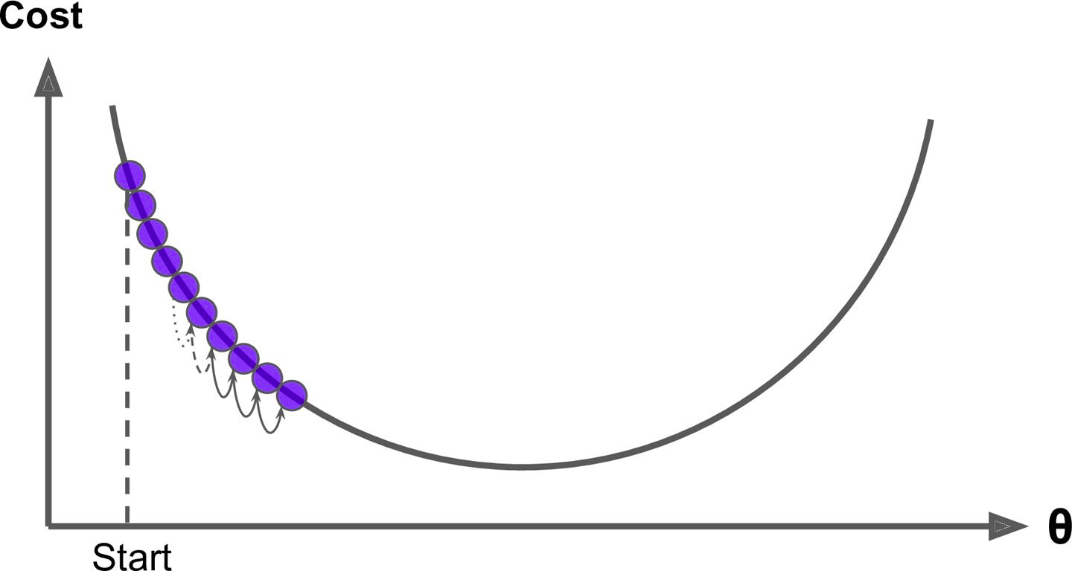
Gradient Descent
Learning Rate
If the learning rate is too small
Then the algorithm will have to go through many iterations to converge
Which will take a long time to converge

Slide 50
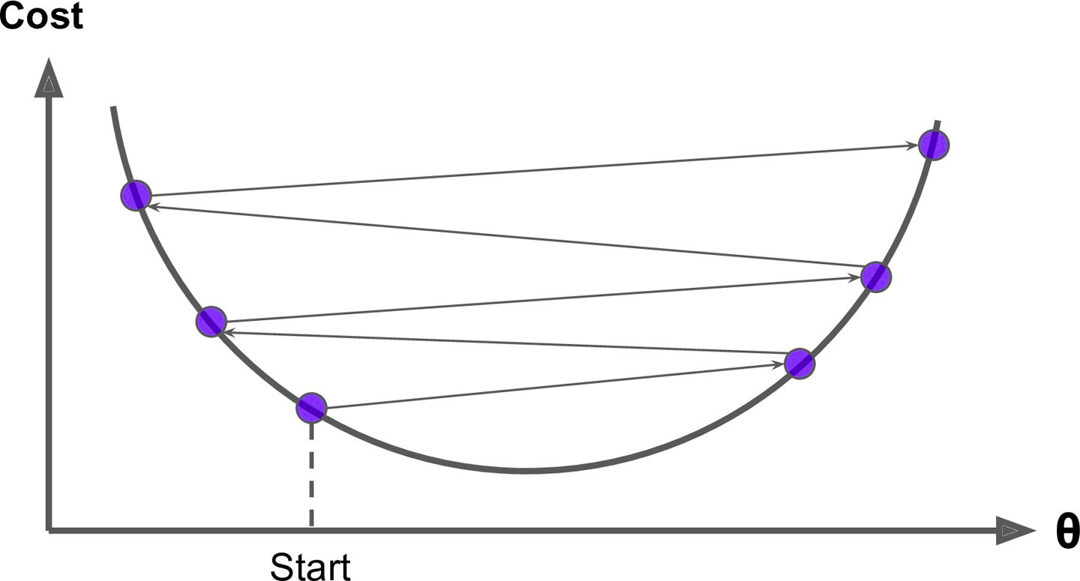
Gradient Descent
Learning Rate
If the learning rate is too high
We might jump across the valley
and end up on the other side, possibly even higher up than you were before

Slide 51
Gradient Descent
Learning Rate
If the learning rate is too high
This might make the algorithm diverge with Larger steps downhill
Algorithm may overshoot the minima

Slide 52
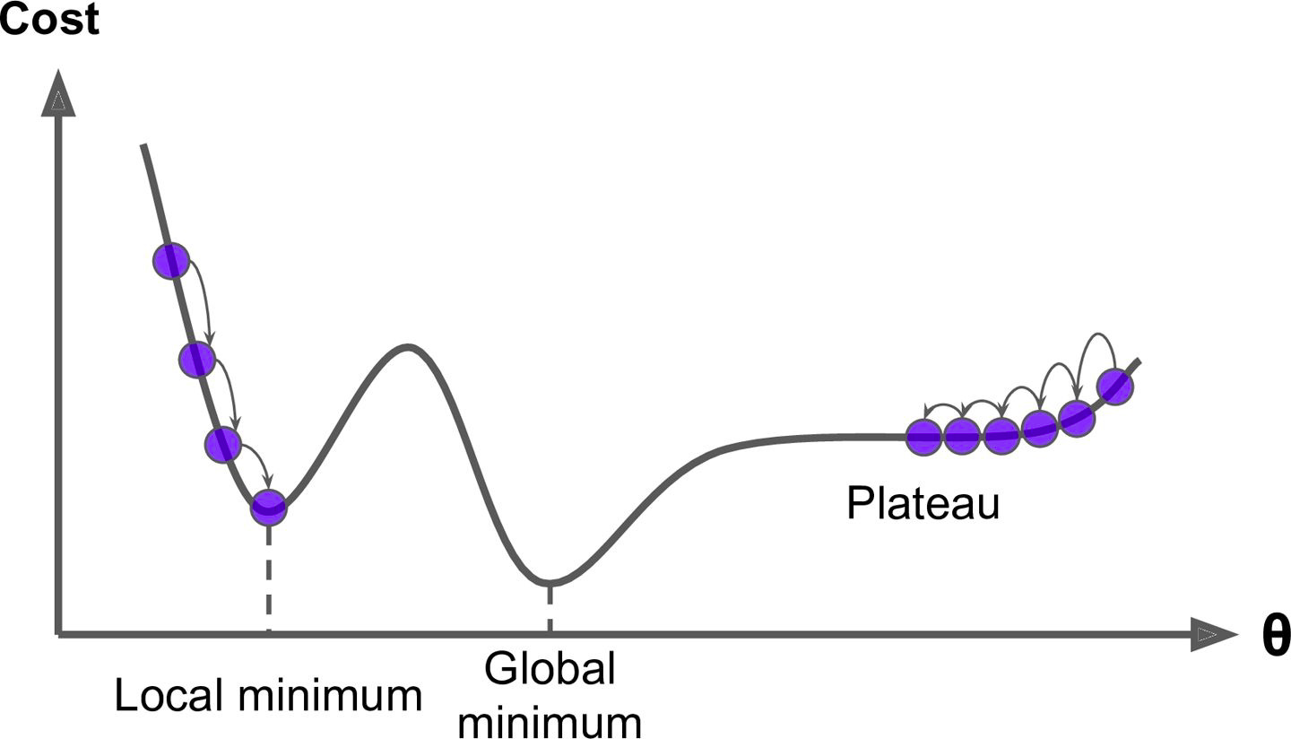
Gradient Descent
Global and Local Minimum
Not all cost functions are regular bowls
There may be holes, ridges, plateaus, and all sorts of irregular terrains, making convergence to the minimum very difficult

Slide 53
Gradient Descent
Global and Local Minimum
If we start from left then Gradient Descent
Converges to a local minimum
Which is not as good as the global minimum

Slide 54
Gradient Descent
Global and Local Minimum
If we start from right then Gradient Descent
Will take a very long time to cross the plateau and
If we stop too early then
We will never reach the global minimum

Slide 55
Gradient Descent
Global and Local Minimum
Mean Square Error (MSE) cost function is a convex function (having one minima only)
If we pick any two points on the curve
The line segment joining them never crosses the curve
No local minima, just one global minimum
Convex Function

Slide 56
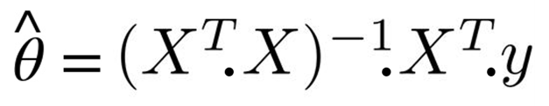
Obtain θ in one attempt: The Normal Equation (another optimization algorithm)
It is a mathematical equation that gives the optimal (minimum error or cost) θ directly
Value of θ that minimizes the cost function
y is the vector of target values containing y⁽¹⁾ to y^{(m)}
More on wikipedia
Notes:
Normal equation is an alternative of gradient descent for linear regression.

Slide 57
The Normal Equation
X is the feature matrix of training dataset y is the output vector
Notes:
https://en.wikipedia.org/wiki/Linear_least_squares_(mathematics)

Slide 58
The Normal Equation
Let’s test the equation

Slide 59
The Normal Equation
First, generate some linear looking data
>>> import numpy as np
# Uniformly distributed array with dimension (100, 1)
>>> X = 2 * np.random.rand(100, 1)
# A variable y which a linear function of X
>>> y = 4 + 3 * X + np.random.randn(100, 1)
θ₀
θ₁
Gaussian Noise
Notes:
Used Numpy library to create a column vector of size (100,1)
Define a variable y which a linear function of X, noise is added to scatter the instances

Slide 60
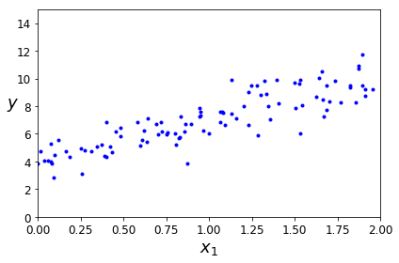
The Normal Equation
Let plot the chart to see if X and y have linear relation
>>> plt.plot(X, y, "b.")
>>> plt.xlabel("$x_1$", fontsize=18)
>>> plt.ylabel("$y$", rotation=0, fontsize=18)
>>> plt.axis([0, 2, 0, 15])
>>> plt.show()
Output

Slide 61
The Normal Equation
Let plot the chart to see if X and y have linear relation
>>> plt.plot(X, y, "b.")
>>> plt.xlabel("$x_1$", fontsize=18)
>>> plt.ylabel("$y$", rotation=0, fontsize=18)
>>> plt.axis([0, 2, 0, 15])
>>> plt.show()
Output
X and y have linear relation

Slide 62
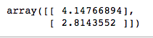
The Normal Equation
Let’s compute theta hat using the Normal Equation
# Add Bias term X₀ = 1 (w₀X₀+w₁.X), so there won’t be any effect of X₀ in computation
>>> X_b = np.c_[np.ones((100, 1)), X]
# Apply the normal equation
>>> theta_best = np.linalg.inv(X_b.T.dot(X_b)).dot(X_b.T).dot(y)
Notes:
c_ object perform concatenation along the second axis

Slide 63
The Normal Equation
Weights in Original Equation
Learned Weights from Normal Equation
y = 4 + 3 * X + np.random.randn(100, 1)
Original
θ₀ = 4
θ₁ = 3
From Normal Equation
θ₀ = 4.14
θ₁ = 2.81

Slide 64
The Normal Equation
Weights in Original Equation
Learned Weights from Normal Equation
y = 4 + 3 * X + np.random.randn(100, 1)
Original
θ₀ = 4
θ₁ = 3
From Normal Equation
θ₀ = 4.14
θ₁ = 2.81
Not bad!
Learned weights are approximately same as original weights

Slide 65
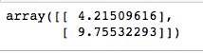
The Normal Equation
Let’s make predictions using theta_best
>>> X_new = np.array([[0], [2]])
# add x0 = 1 to each instance
>>> X_new_b = np.c_[np.ones((2, 1)), X_new]
>>> y_predict = X_new_b.dot(theta_best)
Output-

Slide 66
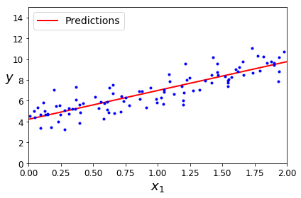
The Normal Equation
Let’s plot the models predictions
>>> plt.plot(X_new, y_predict, "r-", linewidth=2, label="Predictions")
>>> plt.plot(X, y, "b.")
>>> plt.xlabel("$x_1$", fontsize=18)
>>> plt.ylabel("$y$", rotation=0, fontsize=18)
>>> plt.legend(loc="upper left", fontsize=14)
>>> plt.axis([0, 2, 0, 15])
>>> plt.show()
Output-

Slide 67
The Normal Equation
We can also use Scikit-Learn for the previous steps
>>> from sklearn.linear_model import LinearRegression
>>> lin_reg = LinearRegression()
>>> lin_reg.fit(X, y)
>>> lin_reg.intercept_, lin_reg.coef_
Output-

Slide 68
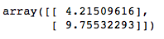
The Normal Equation
>>> lin_reg.predict(X_new)
Output-

Slide 69
The Normal Equation
Computational Complexity - For Features
The Normal Equation
Computes the inverse of X^{T} · X
Which is an n * n matrix (where n is the number of features)
Depending on the the number of features
The computational complexity of inverting such a matrix is very high
Typically about O(n^{2.4}) to O(n³) depending on the implementation
Use gradient descent when n is large

Slide 70
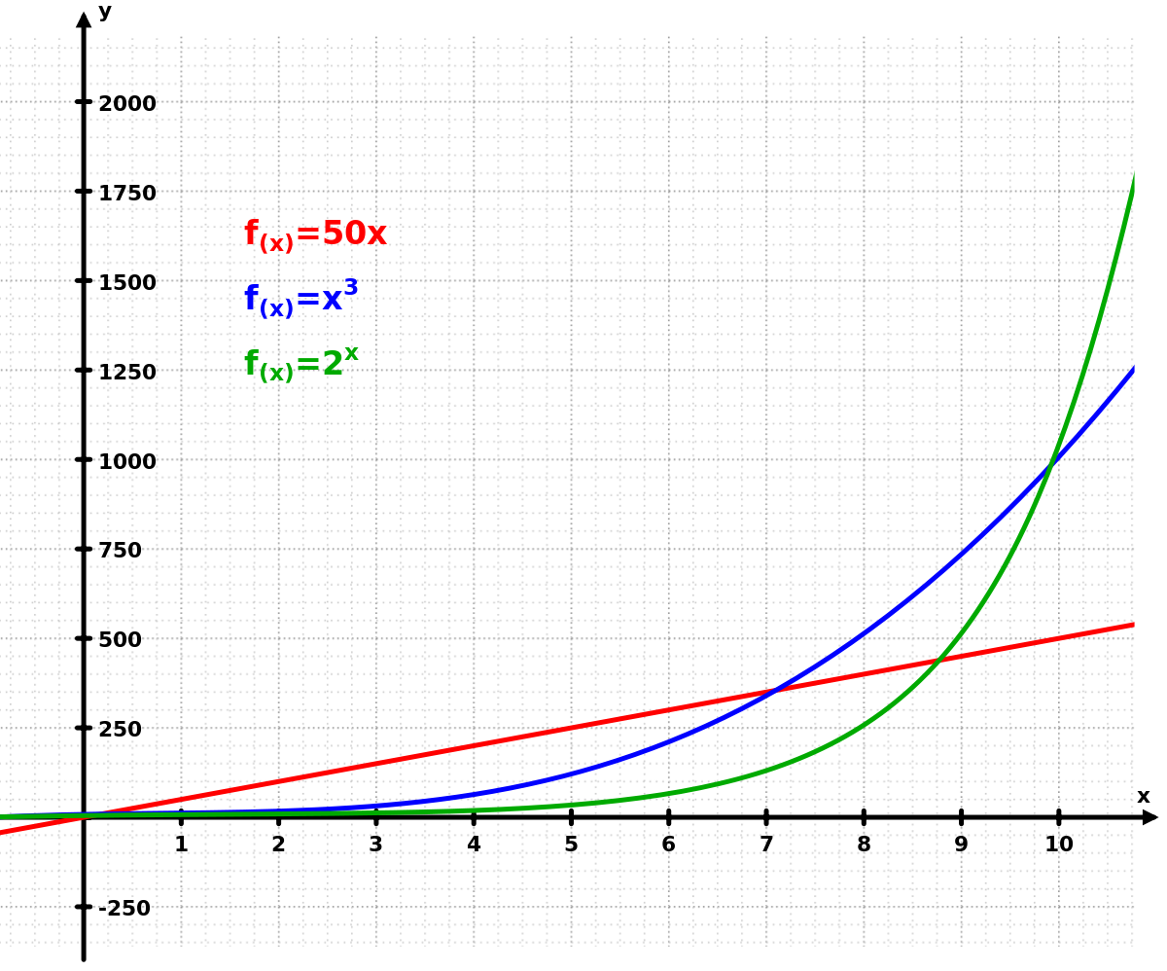
The Normal Equation
Computational Complexity - For Features
If we double the number of features
Then the computation time gets increased by
2^{2.4} to 2³ = (~= 5.3 to 8) times
That is why the Normal Equation gets very slow
When the number of features grows large

Slide 71
The Normal Equation
Computational Complexity - For Training Set
The normal equation is
Linear with regards to the number of instances in the training set
So it handles large training sets efficiently
Provided they can fit in memory

Slide 72
The Normal Equation
Computational Complexity
Let’s explore different ways to train a Linear Regression model which are
Better suited for cases where there are a large number of features
Or too many training instances to fit in memory

Slide 73
Better way to Train Linear Regression Model
Gradient Descent - Tweaks parameters iteratively in order to minimize a cost function

Slide 74
Gradient Descent - A little greedy approach.
6020
Initial Guess
3980
2010
1
2
3
4
Notes:
Say, we start with a random line with some slope and intercept.

Slide 75
Gradient Descent - find impact of slight change
6020
Try Increasing the slope a little bit
Initial Guess
3980
2010
1
2
3
4
Notes:
And then we try increasing the slope a little bit and observe the change in error due to the change in the slope. Here we have three instances 2010, 3980 and 6020. To compute the change in error we will have to check with all the instances.

Slide 76
Gradient Descent - guess next line!
Next line
6020
Try Increasing the slope a little bit
Initial Guess
3980
2010
1
2
3
4
Notes:
If the error is decreasing, we continue to increase slope at a faster pace.

Slide 77
Gradient Descent
Increase in slope is proportional to Rate of decrease of error w.r.t change in slope
Next line
6020
Initial Guess
3980
Try Increasing the slope a little bit
2010
1
2
3
4
Notes:
The question is how much should we change the slope to get the next line after each probe? In simple words, the increase in the slope should be proportional to the rate of decrease in error. The more the change in error, the more we should change the slope.

Slide 78
Gradient Descent
Increase in slope = learning rate * Rate of decrease of error wrt change in slope
Next line
Some constant.
6020
Initial Guess
3980
Try Increasing the slope a little bit
2010
1
2
3
4
Notes:
So, we can say that the increase in slope is equal to some constant multiplied by the rate of decrease in error. Please note that this decrease in error is with respect to the change in slope.

Slide 79
Gradient Descent
New Slope = Old Slope + Learning Rate * Rate of decrease of error wrt change in slope
Next line
6020
Initial Guess
3980
Try Increasing the slope a little bit
2010
1
2
3
4
Notes:
So, now we can say that the new slope is equal to the old slope plus the change. And the change is learning rate which is some constant number multiplied by the rate of decrease in error.

Slide 80
Try Increasing the slope a little bit
Initial Guess
Next line
6020
3980
What if error increased due to increasing slope?
2010
1
2
3
4
Notes:
If the error is increasing with increasing slope, we decrease the slope as in the diagram.
This method is called gradient descent. Gradient means the rate of change and descent means going down. We go to the side where the gradient of error is going down.
Since a line is defined by slope and its distance from the center is called intercept, we do the same tweaking for the intercept too.

Slide 81
Gradient Descent
Start with random line
Notes:
Since the gradient descent is the core algorithm in machine learning and deep learning, we would spend more time on this. Say, we are trying to find a line that fits our data points.
We start with a random line. Here the line is our model because using this line we will be doing the prediction of salaries as we did earlier.

Slide 82
Gradient Descent
Start with random line
Increase the slope a bit
& Calculate change in error
Did the error decrease?
Notes:
We then slightly increase the slope and calculate the change in error. Also, notice that to compute the change in error we will have to consult all the training instances.

Slide 83

Gradient Descent
Start with random line
Increase the slope a bit
& Calculate change in error
Did the error decrease?
Yes
Increase the slope.
Gradient Descent > Flowchart
Notes:
If the error decreased due to increasing the slope, we continue to increase the slope in a greater amount proportional to the rate of change.

Slide 84

Gradient Descent
Start with random line
Increase the slope a bit
& Calculate change in error
Did the error decrease?
Decrease the slope.
No. Error
increased
Yes
Increase the slope.
Notes:
Otherwise if the error has increased, we go in the opposite direction that decreases the slope in the proportion of the rate of change. Larger the change in error per change in slope, larger the tweaking we do in the slope.

Slide 85
Gradient Descent
Start with random line
Increase the slope a bit
& Calculate change in error
Did the error decrease?
Decrease the slope.
No. Error
increased
Yes
Increase the slope.
No, Error didn't change
Stop, you have found the best line
Notes:
If the error didn't change due to change in slope, we stop because we have probably found a line that is the best fit.

Slide 86
Gradient Descent
Start with random line
Increase the slope a bit
& Calculate change in error
Next epoch / iteration
Next epoch / iteration
Did the error decrease?
Decrease the slope.
No. Error
increased
Yes
Increase the slope.
No, Error didn't change
Stop, you have found the best line
Notes:
Afterwards, we go back to tweaking the slope again. It is called the next epoch or next iteration. We continue doing it until we find that the error is no longer changing due to tweaking. The model is the line which has two parameters - slope and the intercept. Also note that the way we tweaked the slope, we would be tweaking the intercept too.

Slide 87
Gradient Descent
Start with random line
Increase the slope a bit
& Calculate change in error
Next epoch / iteration
Next epoch / iteration
Did the error decrease?
Decrease the slope.
No. Error
increased
Yes
Increase the slope.
No, Error didn't change
Stop, you have found the best line
Notes:
Afterwards, we go back to tweaking the slope again. It is called the next epoch or next iteration. We continue doing it until we find that the error is no longer changing due to tweaking. The model is the line which has two parameters - slope and the intercept. Also note that the way we tweaked the slope, we would be tweaking the intercept too.

Slide 88
Feature Scaling
When using Gradient Descent, we should ensure that
All features have a similar scale
Using Scikit-Learn’s StandardScaler class
Else it will take much longer to converge

Slide 89
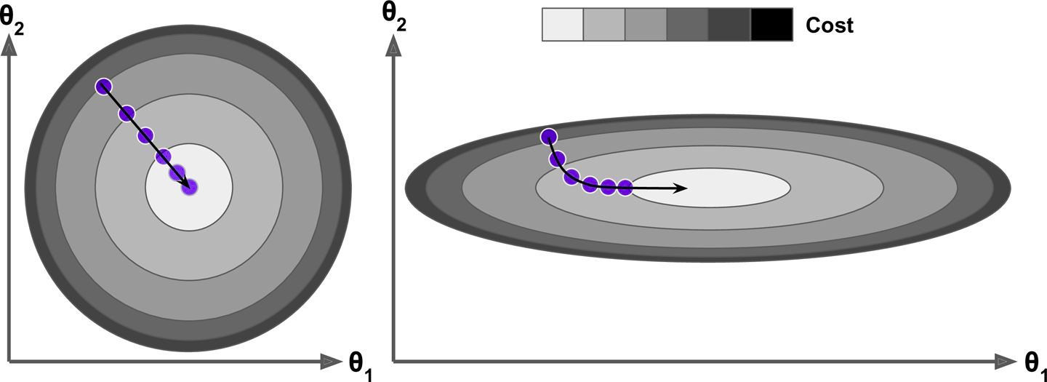
Feature Scaling
Feature Scaling - Same Scales
See the below diagram where feature 1 and 2 have same scales
Gradient Descent algorithm goes straight toward the minimum
Thereby reaching it quickly
Same Scale

Slide 90
Feature Scaling
Feature Scaling - Different Scales / Not scaled
See the below diagram where feature 1 and 2 have different scales
Different Scale

Slide 91
Feature Scaling
Feature Scaling - Different Scales
Gradient Descent algorithm goes almost orthogonal to
The direction of the global minimum and
It ends with a long march down an almost flat valley
It will eventually reach the minimum, but it will take a long time
Different Scale

Slide 92
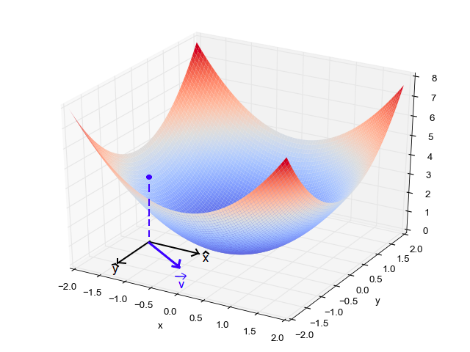
Gradient Descent
Features and Cost Function
Cost
Feature 2
Feature 1

Slide 93
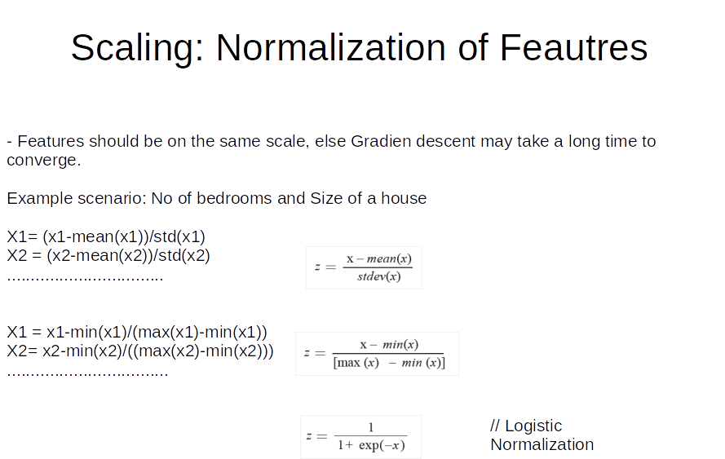

Slide 94
Gradient Descent
Again remember that training a model means
Searching for a best possible model’s parameters
Like θ₀, θ₁ and others
That minimizes the cost function like MSE
Algorithm will have to search in more dimensions if
Model has more features
And search becomes complex

Slide 95
Types of Gradient Descent based on size of input data
Batch Gradient Descent
Stochastic Gradient Descent
Mini-batch Gradient Descent

Slide 96
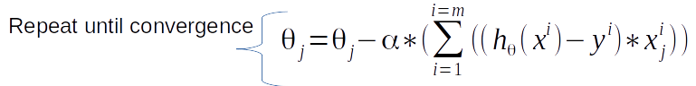
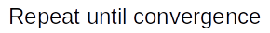
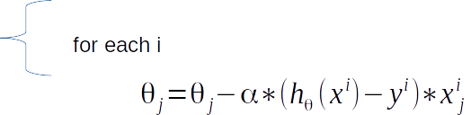
Types of Gradient Descent based on part of the input data to update parameter
Batch Gradient Descent: Looks at every example in the entire training set before taking a single step. //Can be very costly operation if m is too large.
Stochastic Gradient Descent: Update θ with each training example
Notes:
Can explain the partial derivative of dJ(θ )|dθ on board.

Slide 97
Stochastic Vs Batch
- Stochastic gradient descent can get θ close to the minimum much faster than batch gradient descent.
- But may not converge to minima.
- However, approximation of the true minima is reasonably good in practice. Learning rate can help.

Slide 98
Batch Gradient Descent
Partial Derivative
To implement Gradient Descent
First initialize model parameters(θ₁, θ₂ …..) - Random Initialization
For each of the weights, we change one weight and keeping others fixed and calculate the change in cost
This is called a Partial Derivative

Slide 99
Batch Gradient Descent
Partial Derivative
It is like asking
What is the slope of the mountain under my feet if I face east?
And then asking the same question facing north
And so on for all other dimensions

Slide 100
Batch Gradient Descent
Partial Derivative of Cost Function
In general, we compute the gradient of the cost function
With regards to each model parameter

Slide 101
Batch Gradient Descent
Partial Derivative of Cost Function
In this equation
We calculate partial derivative wrt each parameter θj (Theta j) individually
Instead we can compute them all in one go

Slide 102
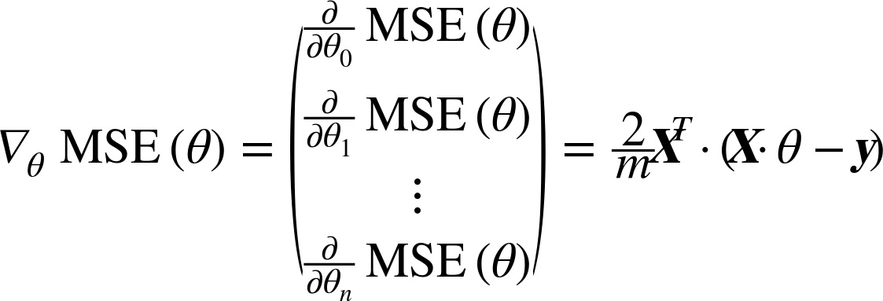
Batch Gradient Descent
Gradient Vector of the Cost Function
The gradient vector ∇_{θ}MSE(θ)
Contains all the partial derivatives of the cost function
(one for each model parameter)

Slide 103
Batch Gradient Descent
Gradient Vector of the Cost Function
The gradient vector ∇_{θ}MSE(θ)
Contains all the partial derivatives of the cost function
(one for each model parameter)

Slide 104
Batch Gradient Descent
Gradient Vector of the Cost Function
This formula involves calculations over the full training set X at every step
This is why the name Batch Gradient Descent

Slide 105
Batch Gradient Descent
Gradient Vector of the Cost Function
This formula involves calculations over the full training set X at every step
This is why the name Batch Gradient Descent

Slide 106
Batch Gradient Descent
Gradient Vector of the Cost Function
Since Batch Gradient Descent uses entire training data at every step
It is terribly slow on large training sets
But Gradient Descent scales well with the number of features
It is faster to train Linear Regression model when there are thousand of features
Using Gradient Descent than using the Normal Equation

Slide 107
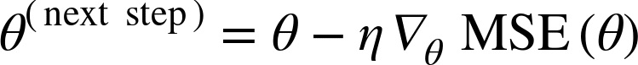
Batch Gradient Descent
Gradient Descent Step
Once we have the gradient vector, which points uphill,
Just go in the opposite direction to go downhill
We can calculate the size of the downhill step using below equation
Learning Rate

Slide 108
Batch Gradient Descent
Check the code of Batch Gradient Descent in Notebook

Slide 109
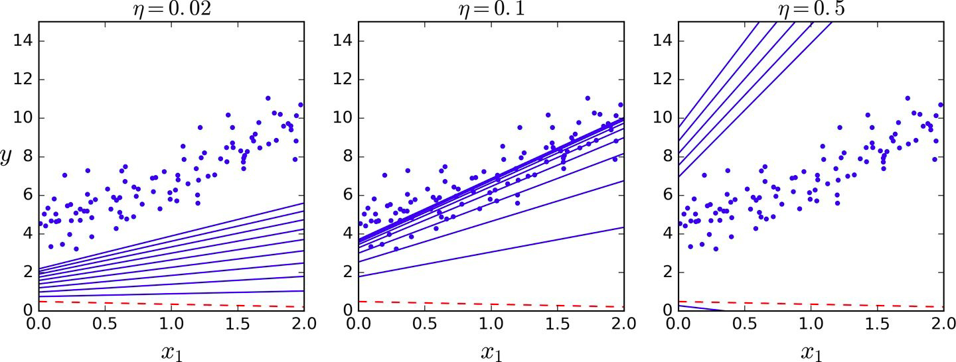
Batch Gradient Descent
First 10 steps of Gradient Descent using three different learning rates
The dashed line - - - - represents the starting point
Gradient Descent with Various Learning Rates (See the code in notebook)

Slide 110
Stochastic Gradient Descent (SGD)

Slide 111
Stochastic Gradient Descent - SGD
Problem with Batch Gradient Descent
Batch Gradient Descent
Slow when the training set is large
As it uses the whole training set to compute the gradient at every step
Stochastic Gradient Descent
Just picks a random instance in the training set at every step and
Computes the gradients based only on that single instance

Slide 112
Stochastic Gradient Descent - SGD
This makes the algorithm much faster
As very little data gets manipulated at every iteration
Also huge training sets can be trained
As only one instance needs to be in memory at each iteration

Slide 113
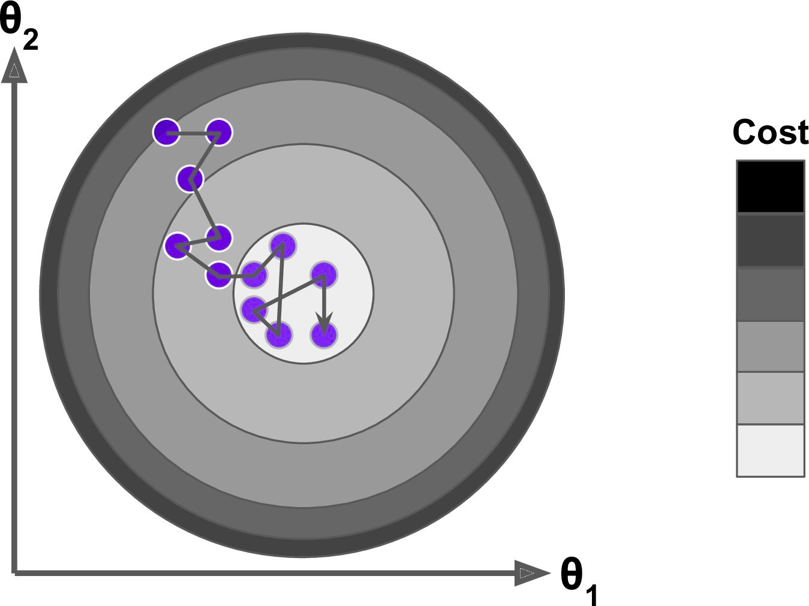
Stochastic Gradient Descent - SGD

Slide 114
Stochastic Gradient Descent - SGD
Instead of gently decreasing until it reaches the minimum
The cost function bounces up and down, decreasing only on average
Over time it ends up very close to the minimum
But once it gets there it continues to bounce around, never settling down

Slide 115
Stochastic Gradient Descent - SGD
Once the algorithm stops
The final parameter values are good, but not optimal
As algorithm never settles down

Slide 116
Stochastic Gradient Descent - SGD
When the cost function is very irregular then
SGD has a better chance of finding the global minimum than Batch Gradient Descent
As randomness may help algorithm to jump out of local minima

Slide 117
Stochastic Gradient Descent - SGD
As seen earlier that randomness in SGD
Is good to escape from local minimum
But bad as algorithm can never settle at minimum

Slide 118
Stochastic Gradient Descent - SGD
As seen earlier that randomness in SGD
Is good to escape from local minimum
But bad as algorithm can never settle at minimum
What is the solution?

Slide 119
Stochastic Gradient Descent - SGD
Simulated Annealing
One solution is to gradually reduce the learning rate
The steps start out large
This helps make quick progress and escape local minima
Then steps get smaller and smaller
This helps the algorithm to settle at the global minimum
This process is called Simulated Annealing
Because it resembles the process of annealing in metallurgy where molten metal is slowly cooled down

Slide 120
Stochastic Gradient Descent - SGD
Learning Schedule
The function that determines the learning rate
At each iteration is called the learning schedule
If the learning rate is reduced too quickly
We may get stuck in a local minimum Or
Even end up frozen halfway to the minimum
If the learning rate is reduced too slowly
We may jump around the minimum for a long time and
End up with a suboptimal solution if we halt training too early

Slide 121
Stochastic Gradient Descent - SGD
Check the code of SGD in Notebook

Slide 122
Mini-batch Gradient Descent

Slide 123
Mini-batch Gradient Descent
The last Gradient Descent algorithm we will look into
Quite easy to understand if we know both
Batch and
Stochastic Gradient Descent

Slide 124
Mini-batch Gradient Descent
At each step
Instead of computing the gradients based on the full training set (as in Batch GD) or
Based on just one instance (as in Stochastic GD)
Mini-batch GD computes the gradients on small random sets of instances called mini-batches

Slide 125
Mini-batch Gradient Descent
Advantages
The main advantage of Mini-batch GD over Stochastic GD is that
We can get a performance boost
From hardware optimization of matrix operations
Especially when using GPUs

Slide 126
Mini-batch Gradient Descent
Advantages
Mini-batch GD algorithm’s progress is
Less erratic than SGD
Especially with fairly large mini-batches
As a result it goes more closer to minimum than SGD

Slide 127
Mini-batch Gradient Descent
Disadvantages
It is harder for Mini-batch GD to escape from local minima

Slide 128
Mini-batch Gradient Descent
Check the code of Mini-batch Gradient Descent in Notebook

Slide 129
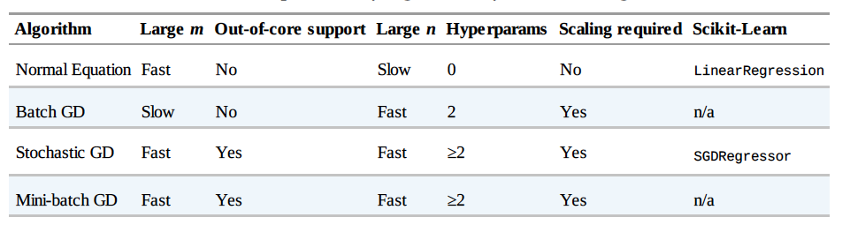
Comparison
m is the number of training instances
n is the number of features

Slide 130
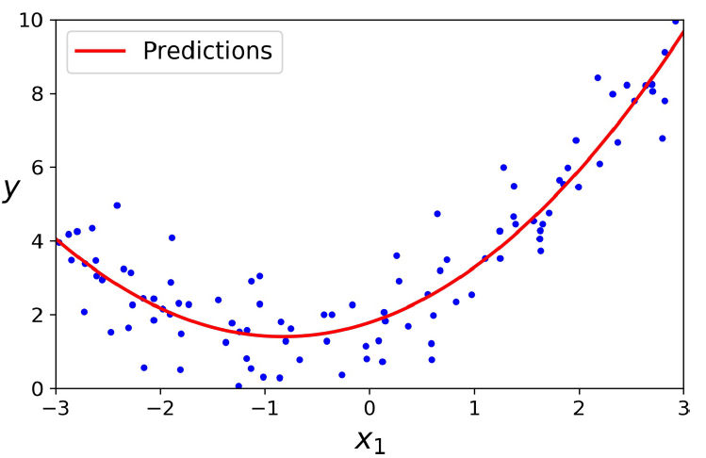
Polynomial Regression
Notes:
We could create a simple algorithm that iterates over all possible lines and keeps the best line so far. Such an algorithm will basically try lines with all possible slopes and distances from the center.
What do you think is the challenge with this? It will take a huge amount of time to come up with the best model even in such a simple case.
Why not try to go to the side where the error is reducing?

Slide 131
Linear Regression
Polynomial Regression

Slide 132
Polynomial Regression
So far we have just looked at the data having
A linear relationship or
Straight line

Slide 133
Polynomial Regression
So far we have just looked the data having
A linear relationship or
Straight line
What if we have to fit nonlinear data like quadratic equation?

Slide 134
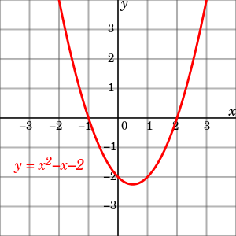
Polynomial Regression
Quadratic Equation
Graph of the quadratic equation y = x^2 - x - 2

Slide 135
Polynomial Regression
Quadratic Equation
Clearly a straight line will never fit this data properly

Slide 136
Polynomial Regression
Quadratic Equation
Then how do we fit this kind of nonlinear data?

Slide 137
Polynomial Regression
We can use
A linear model to fit nonlinear data
Add powers of each feature as new features
And train a linear model on extended set of features
This is called polynomial regression

Slide 138
Polynomial Regression
Let’s test it
First generate some nonlinear data
Based on a quadratic equation
Plus some noise

Slide 139
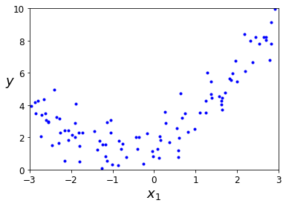
Polynomial Regression
Generate Nonlinear Data with Noise
>>> m = 100
>>> X = 6 * np.random.rand(m, 1) - 3
>>> y = 0.5 * X**2 + X + 2 + np.random.randn(m, 1)
Generated nonlinear and noisy dataset

Slide 140
Polynomial Regression
Scikit-Learn’s PolynomialFeatures Class
Use PolynomialFeatures class to transform the training data
Add square of each feature in the training set as new features
new features = existing features in training set + square of each feature in training set

Slide 141
Polynomial Regression
Scikit-Learn’s PolynomialFeatures Class
>>> from sklearn.preprocessing import PolynomialFeatures
>>> poly_features = PolynomialFeatures(degree=2, include_bias=False)
>>> X_poly = poly_features.fit_transform(X)
>>> X[0]

Slide 142
Polynomial Regression
Scikit-Learn’s PolynomialFeatures Class
>>> X[0]
array([-0.75275929])
Original features
>>> X_poly[0]
array([-0.75275929, 0.56664654])
X_poly now contains the original feature of X plus the square of this feature

Slide 143
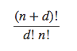
Polynomial Regression
Scikit-Learn’s PolynomialFeatures Class
PolynomialFeatures with degree=d
Transforms an array containing n features into an array containing
features

Slide 144
Polynomial Regression
Scikit-Learn’s PolynomialFeatures Class
Polynomial Regression is capable of finding relationships between features
Which plain Linear Regression model can not do
This is because PolynomialFeatures adds all combinations of features
Up to the given degree

Slide 145
Polynomial Regression
Scikit-Learn’s PolynomialFeatures Class
For example
If there are two features a and b
PolynomialFeatures with degree=3 will add these features alse
a², a³, b², and b³
Also ab, a²b, and ab²

Slide 146
Polynomial Regression
Fit a LinearRegression model
Now fit a LinearRegression model to this extended training data
>>> lin_reg = LinearRegression()
>>> lin_reg.fit(X_poly, y)
>>> lin_reg.intercept_, lin_reg.coef_

Slide 147
Polynomial Regression
Fit a LinearRegression model
Output -
(array([ 1.78134581]), array([[ 0.93366893, 0.56456263]]))
Model Estimation -

Slide 148
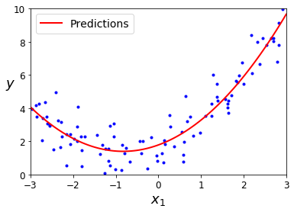
Polynomial Regression
Polynomial Regression model predictions

Slide 149
Linear Regression
Learning Curves

Slide 150
Learning Curves
As we have seen earlier
High-degree polynomial regression fits the training data
Much better than plain linear regression
Let’s look at the fit of
Plain Linear Regression
2nd-degree Polynomial Regression and
300-degree Polynomial Regression
See the code in Learning curves section in notebook

Slide 151
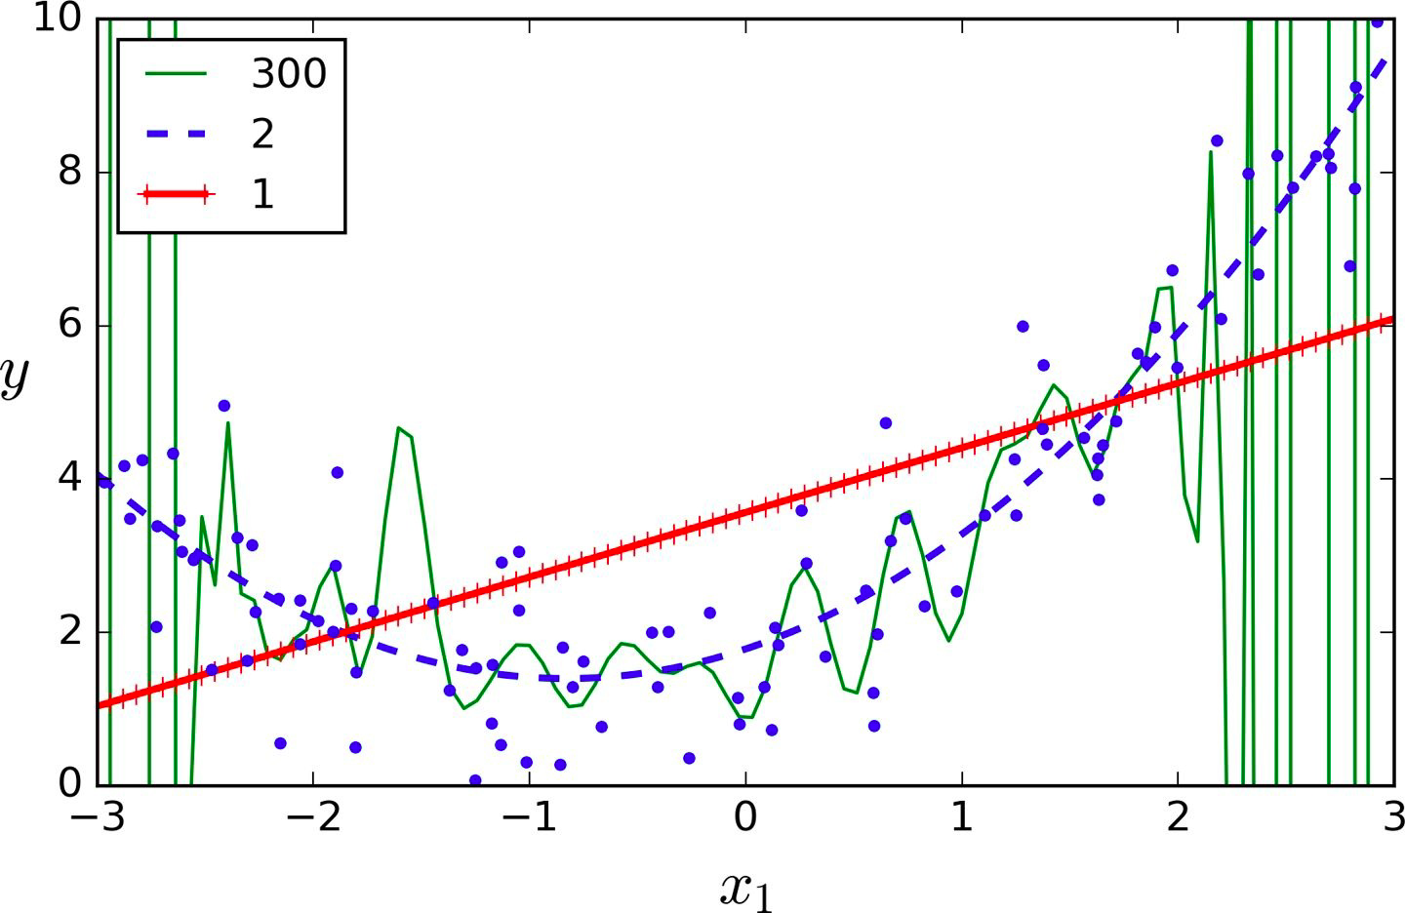
Learning Curves
High-degree Polynomial Regression

Slide 152
Learning Curves
-- Plain Linear
Regression
-- 2nd-degree Polynomial
Regression
-- 300-degree Polynomial
Regression

Slide 153
Learning Curves
As we can see in the previous diagram
300-degree polynomial model
Wiggles around to get as close as possible
To the training instances
It is clear that
The high-degree Polynomial Regression model is severely overfitting the training data and
The linear model is underfitting the training data

Slide 154
Learning Curves
How do we find if model is overfitting or underfitting the training data?

Slide 155
Learning Curves
One approach is to use cross-validation

Slide 156
Learning Curves
If a model
Performs well on the training data
But generalizes poorly according to the cross-validation
Then model is overfitting
In this case model is too complex
If a model
Performs poorly on both
Training data and cross-validation
Then model is underfitting
In this case model is too simple

Slide 157
Learning Curves
Another approach is to look at learning curves

Slide 158
Learning Curves
Learning curves are
Plots of the model’s performance on
The training set and the validation set
As a function of the training set size
To generate the plots
Simply train the model
Several times on different sized subsets of the training set

Slide 159
Learning Curves
Learning curves of the plain Linear Regression model
Let’s plot the learning curves
We’ll train the model on different subsets of training set
And plot the RMSE and Training set size
Switch to the notebook for the code

Slide 160
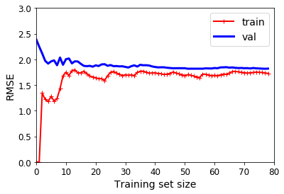
Learning Curves
Learning curves of the plain Linear Regression model

Slide 161
Learning Curves
Let’s look at performance of the model on the training set
When there are just one or two instances in the training set
The model can fit them perfectly
Which is why the curve starts at zero

Slide 162
Learning Curves
Let’s look at performance of the model on the training set
But as new instances are added to the training set
It becomes impossible for the model to fit the training data perfectly
Both because the data is noisy and
Because it is not linear at all

Slide 163
Learning Curves
Let’s look at performance of the model on the training set
The error on the training data goes up until it reaches a plateau
At that point adding new instances to the training set
Doesn’t make the error much better or worse

Slide 164
Learning Curves
Let’s look at performance of the model on the validation set
When the model is trained on very few training instances
It is incapable of generalizing properly
Which is why the validation error is initially quite big

Slide 165
Learning Curves
Let’s look at performance of the model on the validation set
As the model is shown more training examples
It learns and thus the validation error slowly goes down

Slide 166
Learning Curves
Let’s look at performance of the model on the validation set
Since straight line can not do a good job modeling the data
So the error ends up at a plateau
Very close to the other curve

Slide 167
Learning Curves
Tip
These learning curves are examples of an underfitting model
Both curves have reached a plateau
They are close and RMSE is fairly high

Slide 168
Learning Curves
Tip
If model is underfitting the training data
Then adding more training data will not help
We need to use a more complex model or
Come up with better features

Slide 169
Learning Curves
Let’s plot the learning curves of a 10th-degree polynomial model on the same data
Switch to the notebook for the code

Slide 170
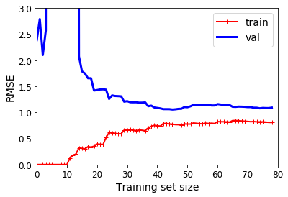
Learning Curves
Learning curves of a 10th-degree polynomial model

Slide 171
Learning Curves
Observations
The error on the training data (~0.5 RMSE) is much lower than with the Linear Regression model (~1.5 - 2 RMSE)

Slide 172
Learning Curves
Observations
There is a gap between the curves
This means that the model performs significantly better on the
Training data than on the validation data
Which shows model is overfitting the training set

Slide 173
Learning Curves
Observations
On a larger training set
The two curves continue to get closer

Slide 174
Learning Curves
Tip
One way to improve an overfitting model is to
Feed it more training data
Until the validation error reaches the training error

Slide 175
Learning Curves
The Bias / Variance Tradeoff
A model’s generalization error can be expressed as the sum of three very different errors
Bias
Variance and
Irreducible error

Slide 176
Learning Curves
The Bias / Variance Tradeoff - Bias error
This error is due to wrong assumptions such as
Assuming that the data is linear
When it is actually quadratic
A high-bias model is most likely to underfit the training data

Slide 177
Learning Curves
The Bias / Variance Tradeoff - Variance
A model with many degrees of freedom
Such as a high-degree polynomial model is likely to have
High variance and thus overfits the training data

Slide 178
Learning Curves
The Bias / Variance Tradeoff - Irreducible error
This error is due to the noisiness of the data itself
The only way to reduce this part of the error is to
Clean up the data
Such as fix
The data sources
Broken sensors or
Detect and remove outliers

Slide 179
Learning Curves
The Bias / Variance Tradeoff
Increasing a model’s complexity
Increases its variance and
Reduce its bias
Conversely, reducing a model’s complexity
Increases its bias and
Reduces its variance
This is why it is called a tradeoff

Slide 180
Regularized Linear Models

Slide 181
Regularized Linear Models
As we saw earlier, a good way to reduce overfitting is to
Regularize the model - Constraint it
It is hard for a model to overfit data if it has less degree of freedom
Example
To regularize a polynomial model, reduce the number of polynomial degrees

Slide 182
Regularized Linear Models
For a linear model
Regularization is achieved by
Constraining the weights of the model
There are different ways to constrain the weights like
Ridge Regression
Lasso Regression and
Elastic Net

Slide 183
Regularized Linear Models
Let’s understand L1 and L2 norms first

Slide 184
Regularized Linear Models
Different Performance Measures
We’ve already looked into RMSE (Root Mean Square Error) as a performance measure
RMSE is generally the preferred performance measure for regression tasks
But in some cases we may want to use another performance measure
Like MAE - Mean Absolute Error
Also called the Average Absolute Deviation
MAE is particularly useful when there are many outliers

Slide 185
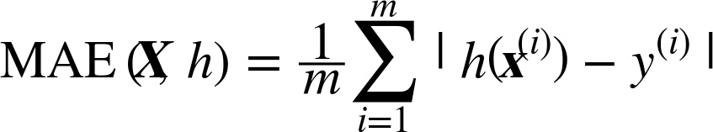
Regularized Linear Models
Mean Absolute Error

Slide 186
Regularized Linear Models
Both RMSE and MAE are ways to measure distances
Between two vectors
Predictor values vector and target values vector
There are various distance measures or norm to calculate distance between two vectors
Manhattan Norm
Euclidean Norm

Slide 187
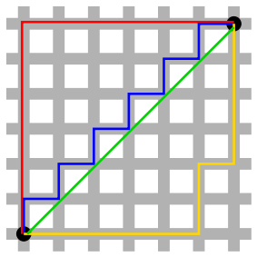
Regularized Linear Models
B
A
Different paths between point A and B

Slide 188
Regularized Linear Models
B
Euclidean Distance
Manhattan Distance
A
Different paths between point A and B
Red, Yellow and Blue paths (If we can only travel along orthogonal city blocks) - Manhattan Distance
Green path - Euclidean Distance

Slide 189
Regularized Linear Models
L1 norm
Computing the sum of absolutes (MAE) corresponds to L1(ℓ₁) norm
Denoted as
∥ · ∥₁
Also called as Manhattan norm

Slide 190
Regularized Linear Models
L2 norm
Computing the root of a sum of squares(RMSE) corresponds to L2(ℓ₂) norm
Denoted as
∥ · ∥₂ or just ∥ · ∥
Also called as Euclidean norm

Slide 191
Regularized Linear Models
ℓ_{k} norm
The ℓ_{k} norm of a vector v containing n elements is defined as
ℓ₀ just gives the cardinality of the vector
i.e., the number of elements
And ℓ∞ gives the maximum absolute value in the vector

Slide 192
Regularized Linear Models
ℓ_{k} norm
The higher the norm index
The more it focuses on large values and
Neglects small ones
This is why the RMSE is
More sensitive to outliers than the MAE
But when outliers are exponentially rare (like in a bell-shaped curve)
The RMSE performs very well and is generally preferred

Slide 193
Regularized Linear Models
L1 vs L2 Regularization
L1 can yield sparse models while L2 doesn't
Sparse models help in feature selection
Which features are important and
Which features are redundant

Slide 194
Regularized Linear Models
Let’s understand Ridge, Lasso and Elastic Net now

Slide 195
Regularized Linear Models
Ridge Regression

Slide 196
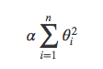
Ridge Regression
Ridge Regression is a regularized version of Linear Regression
A regularization term is added to the cost function
Regularization term

Slide 197
Ridge Regression
Adding a regularization term to cost function
Forces the learning algorithm to not only fit the data
But also keep the model weights as small as possible
Note that
Regularization term should only be added to the cost function during training
Once the model is trained we evaluate the model’s performance using the unregularized performance measure

Slide 198
Ridge Regression
Question
Why add the regularization term only during the training not while evaluating the model performance during testing?

Slide 199
Ridge Regression
Answer
Cost function should have optimization- friendly weights during training
While the performance measure used for testing should be as close as possible to the final objective
This is why we evaluate the model’s performance using the unregularized performance measure

Slide 200
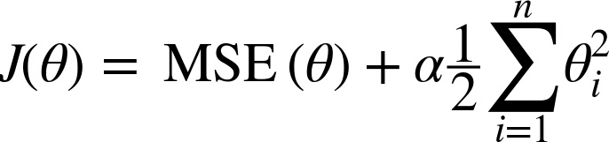
Ridge Regression
Ridge Regression Cost Function
The hyperparameter “𝜶” controls
How much you want to regularize the model
If 𝜶 = 0
Then Ridge Regression is just Linear Regression

Slide 201
Ridge Regression
Ridge Regression Cost Function
Note that the bias term θ₀ is not regularized
As the sum starts at i = 1, not 0
We are just constraining the weights of features hence
Regularization of bias term is not required

Slide 202
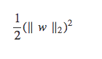
Ridge Regression
Ridge Regression Cost Function
If w is the vector of feature weights (θ₁ to θ_{n})
Then the regularization term is equal to
Where ∥ · ∥₂ represents the l₂ (L2) norm of the weight vector

Slide 203
Ridge Regression
Important point
Please make sure to
Scale the data (e.g., using a StandardScaler)
Before performing Ridge Regression
As Ridge Regression is sensitive to the scale of input features

Slide 204
Ridge Regression
Let’s train models using Ridge Regression on some linear data using different 𝜶 value

Slide 205
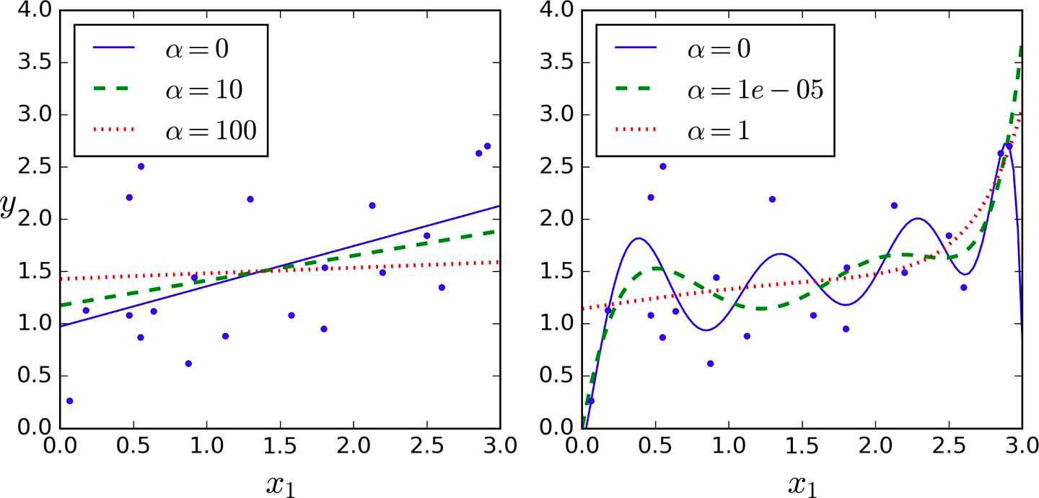
Ridge Regression
Plain Ridge models, leading to linear predictions

Slide 206
Ridge Regression
Polynomial Regression with Ridge regularization (See the code in notebook)
Data is first expanded using PolynomialFeatures(degree=10)
Then scaled using a StandardScaler
Finally the Ridge models are applied to the resulting features

Slide 207
Ridge Regression
Polynomial Regression with Ridge regularization
Increasing 𝜶 leads to
flatter - less extreme, more reasonable predictions
This reduces the model’s variance but increases its bias

Slide 208
Ridge Regression
Implementing Ridge Regression
Like Linear Regression we can perform Ridge Regression either
By computing a closed-form equation or
By performing Gradient Descent

Slide 209
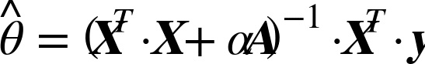
Ridge Regression
Implementing Ridge Regression - closed-form Solution
Where A is the
n * n identity matrix
except with a 0 in the top-left cell - The bias term

Slide 210
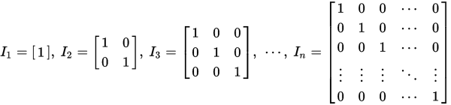
Ridge Regression
Implementing Ridge Regression - closed-form Solution
Identity matrices with ones on the main diagonals and zeros elsewhere

Slide 211
Ridge Regression
Ridge Regression with Scikit-Learn using a closed-form solution
>>> from sklearn.linear_model import Ridge
>>> ridge_reg = Ridge(alpha=1, solver="cholesky", random_state=42)
>>> ridge_reg.fit(X, y)
>>> ridge_reg.predict([[1.5]])
Output-
array([[ 1.55071465]])

Slide 212
Ridge Regression
Ridge Regression with Scikit-Learn using Stochastic Gradient Descent
>>> sgd_reg = SGDRegressor(penalty="l2", random_state=42)
>>> sgd_reg.fit(X, y.ravel())
>>> sgd_reg.predict([[1.5]])
The penalty hyperparameter sets the type of regularization term to use
Specifying "l2" (L2) means
We want SGD to add a regularization term to the cost function
Equal to half the square of the l2 norm of the weight vector

Slide 213
Ridge Regression
Ridge Regression with Scikit-Learn using Stochastic Gradient Descent
>>> sgd_reg = SGDRegressor(penalty="l2", random_state=42)
>>> sgd_reg.fit(X, y.ravel())
>>> sgd_reg.predict([[1.5]])
Output-
array([ 1.13500145])

Slide 214
Regularized Linear Models
Lasso Regression

Slide 215
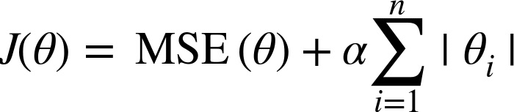
Lasso Regression
Least Absolute Shrinkage and Selection Operator Regression
Like Ridge regression, a regularization term is added to the cost function
But it uses the L1 norm of the weight vector instead of half the square of the L2 norm
Lasso Regression cost function

Slide 216
Lasso Regression
Let’s train models using Lasso Regression on some linear data using different 𝜶 value
(See the code in notebook)

Slide 217
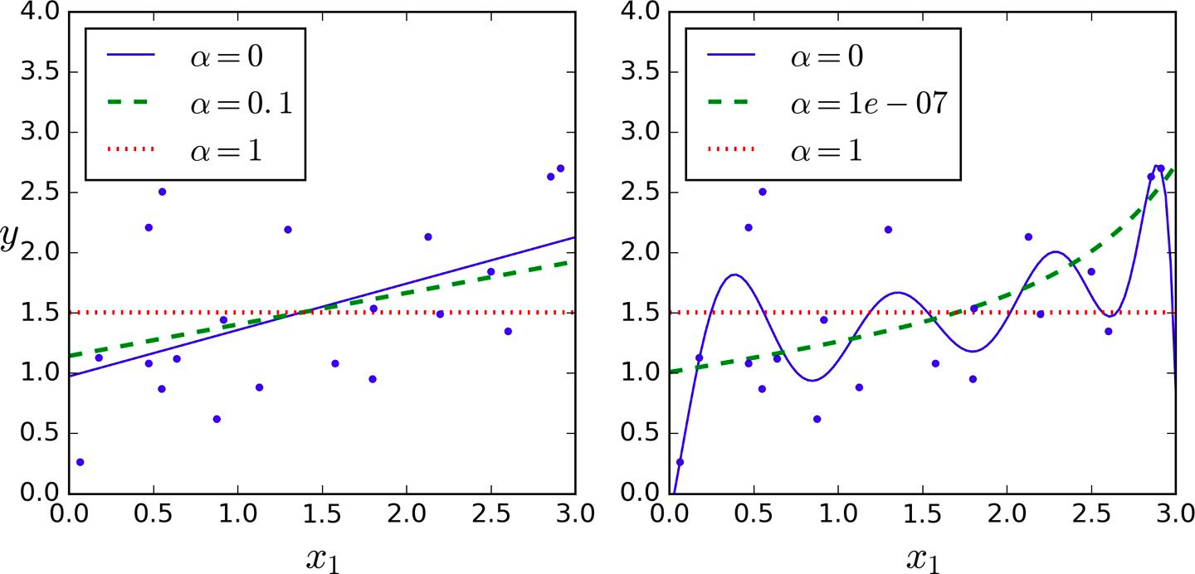
Lasso Regression
Lasso Regression for Different Values of Alpha
Plain Linear Regression
Polynomial Regression

Slide 218
Lasso Regression
An important characteristic of Lasso Regression
It completely eliminates the weights of the least important features
Sets them to zero

Slide 219
Lasso Regression
Lasso Regression automatically performs feature selection and
Outputs a sparse model
i.e, the model with few nonzero feature weights

Slide 220
Lasso Regression
The dashed green line (with α = 10⁻⁷) in the right plot
Looks quadratic, almost linear
All the weights for the high-degree polynomial features are equal to zero
Notes:
Missing Figure 4-19. Lasso versus Ridge regularization

Slide 221
Lasso Regression
Lasso Regression using Scikit-Learn
>>> from sklearn.linear_model import Lasso
>>> lasso_reg = Lasso(alpha=0.1)
>>> lasso_reg.fit(X, y)
>>> lasso_reg.predict([[1.5]])
Output-
array([ 1.53788174])

Slide 222
Regularized Linear Models
Elastic Net

Slide 223
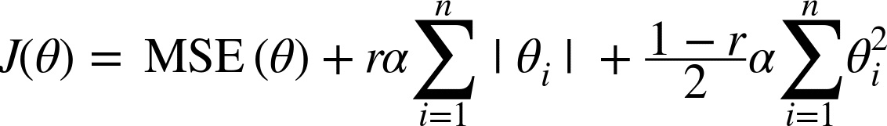
Elastic Net
Elastic Net is middle ground
Between Ridge Regression and Lasso Regression
The regularization term is a
Simple mix of both Ridge and Lasso’s regularization terms
Elastic Net cost function
Lasso’s regularization term
Ridge regularization term

Slide 224
Elastic Net
When r = 0
Elastic Net is equivalent to Ridge Regression
Elastic Net cost function
When r=0
Ridge Regression cost function

Slide 225
Elastic Net
When r = 1
Elastic Net is equivalent to Lasso Regression
Elastic Net cost function
When r=1
Lasso Regression cost function

Slide 226
Elastic Net
So when should we use Linear Regression, Ridge, Lasso, or Elastic Net?

Slide 227
Elastic Net
Linear Regression, Ridge, Lasso, or Elastic Net
We should avoid plain Linear Regression
Always preferable to have at least
A little bit of regularization
Ridge is a good default
But if we think only few features are useful
We should prefer Lasso or
Elastic Net
As they reduce the useless features’ weights down to zero

Slide 228
Elastic Net
Linear Regression, Ridge, Lasso, or Elastic Net
In general, Elastic Net is preferred over Lasso
Since Lasso may behave erratically
When the number of features
Is greater than the number of training instances or
When several features are strongly correlated

Slide 229
Elastic Net
Implement Elastic Net using Scikit-Learn
>>> from sklearn.linear_model import ElasticNet
>>> # l1_ratio corresponds to the mix ratio r
>>> elastic_net = ElasticNet(alpha=0.1, l1_ratio=0.5, random_state=42)
>>> elastic_net.fit(X, y)
>>> elastic_net.predict([[1.5]])
Output-
array([ 1.54333232])

Slide 230
Regularized Linear Models
Early Stopping

Slide 231
Early Stopping
A different way to
Regularize iterative learning algorithms
Such as Gradient Descent is
To stop training as soon as the
Validation error reaches a minimum
This is called early stopping

Slide 232
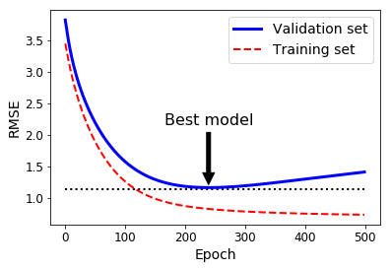
Early Stopping
High-degree Polynomial Regression model trained using Batch Gradient Descent
(See the code in the notebook)

Slide 233
Early Stopping
As the epochs increases the algorithm learns and
Its prediction error (RMSE) on the training set goes down and
So does its prediction error on the validation set

Slide 234
Early Stopping
After a while the
Validation error starts increasing
This indicates that the
Model has started to overfit the training data

Slide 235
Early Stopping
Stop at this point
With early stopping
We just stop training as soon as the
Validation error reaches the minimum

Slide 236
Early Stopping
Tip
In previous example of Batch Gradient Descent
The curve was smooth
That is why we could locate the minimum easily
With Stochastic and Mini-batch Gradient Descent
The curves are not so smooth and
It may be hard to know whether
We have reached the minimum or not

Slide 237
Early Stopping
Tip
One solution is to
Stop only after the validation error
Has been above the minimum for some time
Then roll back the model parameters to the point
Where the validation error was at a minimum

Slide 238
Early Stopping
See the code in notebook for basic implementation of early stopping

Slide 239
Training Models
Logistic Regression

Slide 240
Logistic Regression
Logistic Regression is a binary classifier
It is used to
Estimate the probability that
An instance belongs to a particular class

Slide 241
Logistic Regression
Positive and Negative Class
Example
What is the probability that this email is spam?
If the estimated probability is
Greater than 50%
Then the instance belong to that class
Positive class is labeled as “1”
Else it predicts that
Instance does not belongs to that class
Negative class is labeled as “0”

Slide 242
Logistic Regression
Estimating Probabilities

Slide 243
Estimating Probabilities
Just like a Linear Regression model, a Logistic Regression model
Computes the weighted sum of
The input features plus a bias term
Unlike Linear Regression model, a Logistic Regression model, Outputs
0 or 1
the logistic of result

Slide 244
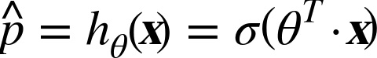
Estimating Probabilities
Logistic Regression Model Estimated Probability
σ -The logistic or Sigmoid function

Slide 245


Estimating Probabilities
Logistic or Sigmoid Function
Outputs a number between 0 and 1

Slide 246

Estimating Probabilities
Logistic Regression Model Estimated Probability
Once the probability p^ (p-hat) is estimated
Make predictions y^ (y-hat) using below equation

Slide 247
Estimating Probabilities
σ(t) < 0.5 when t < 0 and
σ(t) ≥ 0.5 when t ≥ 0
So a Logistic Regression model predicts
1 if θ^{T} · X is positive and
0 if it is negative

Slide 248
Logistic Regression
Training and Cost Function

Slide 249
Training and Cost Function
Let’s understand how to train a Logistic Regression model
The objective of training is to
Set the parameter vector θ so that model estimates
High probabilities for positive instances (y = 1) and
Low probabilities for negative instances (y = 0)

Slide 250

Training and Cost Function
Cost function of a single training instance
Note that in case of classification y can have only two values 0 and 1

Slide 251

Training and Cost Function
c(θ)
c(θ)
c(θ) = -log(p^)
c(θ)= -log(1-p^)

Slide 252
Training and Cost Function
y = -log(p^)
c(θ)
p^
If y = 1 and p^ = 1(both actual and predicted probability are one)
Then Cost = 0

Slide 253
Training and Cost Function
y = -log(p^)
c(θ)
p^
If y = 1 and p^ = 0 (Predicted probability is different from actual value)
As p^ -> 0, cost -> infinity
We penalize learning algorithm by a very large cost

Slide 254
Training and Cost Function
y = -log(1-p^)
c(θ)
p^
If y = 0, p^ = 1 (Predicted probability is different from actual value)
Then cost -> infinity
We penalize learning algorithm by a very large cost

Slide 255
Training and Cost Function
y = -log(1-p^)
c(θ)
p^
If y = 0, p^ = 0 (both actual and predicted probability are zero)
Then cost = 0

Slide 256

Training and Cost Function
Logistics Regression Cost Function

Slide 257
Logistic Regression
Decision Boundaries

Slide 258
Decision Boundaries
Let’s use the iris dataset to illustrate Logistic Regression
This is the famous dataset
That contains the sepal and petal length and width of
150 iris flowers of three different species
Iris-Setosa
Iris-Versicolor and
Iris-Virginica

Slide 259

Decision Boundaries
Flowers of three iris plant species

Slide 260

Decision Boundaries

Slide 261

Decision Boundaries
IRIS Dataset

Slide 262
Decision Boundaries
Let’s look at the dataset
>>> from sklearn import datasets
>>> iris = datasets.load_iris()
>>> list(iris.keys())
Output -
['data', 'target', 'target_names', 'DESCR', 'feature_names']

Slide 263
Decision Boundaries
Let’s look at the dataset
>>> from sklearn import datasets
>>> iris = datasets.load_iris()
>>> list(iris.keys())
Output -
['data', 'target', 'target_names', 'DESCR', 'feature_names']
Let’s look at the keys

Slide 264
Decision Boundaries
Check description of dataset
['data', 'target', 'target_names', 'DESCR', 'feature_names']
>>> print(iris.DESCR)
Check the description in notebook

Slide 265

Decision Boundaries
Check data
['data', 'target', 'target_names', 'DESCR', 'feature_names']
>>> print(iris.data)
Output -
Sepal Width (in cm)
Sepal Length (in cm)
Petal Length (in cm)
Petal Width (in cm)

Slide 266
Decision Boundaries
Check features_names
['data', 'target', 'target_names', 'DESCR', 'feature_names']
>>> print(iris.feature_names)
Output -
['sepal length (cm)', 'sepal width (cm)', 'petal length (cm)', 'petal width (cm)']

Slide 267

Decision Boundaries
Check target
['data', 'target', 'target_names', 'DESCR', 'feature_names']
>>> print(iris.target)
Output -
There are 150 targets with 50 0s, 50 1s and 50 2s
What does 0, 1 and 2 means here?

Slide 268

Decision Boundaries
Check target_names
['data', 'target', 'target_names', 'DESCR', 'feature_names']
>>> print(iris.target_names)
Output -
0
1
2

Slide 269
Decision Boundaries
Now let’s build a classifier to detect the Iris-Virginica type based only on the petal width feature

Slide 270
Decision Boundaries
Train a Logistic Regression model
>>> X = iris["data"][:, 3:] # petal width
>>> y = (iris["target"] == 2).astype(np.int) # 1 if Iris-Virginica, else 0
>>> from sklearn.linear_model import LogisticRegression
>>> log_reg = LogisticRegression(random_state=42)
>>> log_reg.fit(X, y)

Slide 271
Decision Boundaries
Now let’s look at the model’s estimated probabilities
For flowers with petal widths varying from 0 to 3 cm
>>> X_new = np.linspace(0, 3, 1000).reshape(-1, 1)
>>> y_proba = log_reg.predict_proba(X_new)
>>> plt.plot(X_new, y_proba[:, 1], "g-", linewidth=2, label="Iris-Virginica")
>>> plt.plot(X_new, y_proba[:, 0], "b--", linewidth=2, label="Not Iris-Virginica")

Slide 272

Decision Boundaries
Output-
Estimated probabilities and decision boundary

Slide 273
Decision Boundaries
The petal width of Iris-Virginica flowers
Represented by triangles
Ranges from 1.4 cm to 2.5 cm

Slide 274
Decision Boundaries
Other Iris flowers
Represented by Squares
Have a smaller petal width
Ranging from 0.1 cm to 1.8 cm

Slide 275
Decision Boundaries
Notice there is a bit of overlap
How does classifier predicts then?

Slide 276
Decision Boundaries
Above about 2 cm
The classifier is highly confident that the
Flower is an Iris-Virginica
As it outputs a high probability to that class

Slide 277
Decision Boundaries
While below 1(one) cm
The classifier is highly confident that the
Flower is not an Iris-Virginica
As it outputs a high probability for the “Not Iris-Virginica” class

Slide 278
Decision Boundaries
There is a decision boundary at around 1.6 cm
Where both probabilities are equal to 50%

Slide 279
Decision Boundaries
If the petal width is higher than 1.6 cm
The classifier will predict that the flower is an Iris-Virginica
Or else it will predict that it is not

Slide 280
Decision Boundaries
Let’s check the predictions
>>> log_reg.predict([[1.7], [1.5]])
Output-
array([1, 0])

Slide 281
Decision Boundaries
Now let’s build a classifier to detect the Iris-Virginica type based on petal width and length

Slide 282
Decision Boundaries
Now the the Logistic Regression classifier
Estimates the probability that a
New flower is an Iris-Virginica based on
Petal width and
Petal length features
Check out the code in Jupyter notebook

Slide 283

Decision Boundaries
Linear decision boundary

Slide 284
Decision Boundaries
The dashed line represents the points
Where the model estimates a 50% probability
This is the model’s decision boundary

Slide 285
Decision Boundaries
Each parallel line represents the points
Where the model outputs a specific probability
from 15% (bottom left) to 90% (top right)

Slide 286
Decision Boundaries
All the flowers beyond the top-right line
Have an over 90% chance of being Iris-Virginica

Slide 287
Decision Boundaries
Regularization
Like linear models, Logistic Regression models can be regularized
Using L1 or L2 penalties
Scikit-Learn adds an L2 penalty by default

Slide 288
Logistic Regression
Softmax Regression

Slide 289
Softmax Regression
The Logistic Regression model
Can be generalized to support multiple classes
Without having to train and combine multiple binary classifiers
This is called Softmax Regression or Multinomial Logistic Regression
Let’s do a quick hands-on on Softmax Regression before going into theory

Slide 290
Softmax Regression
Let’s classify the iris flowers into all three classes
>>> # Softmax Regression
>>> X = iris["data"][:, (2, 3)] # petal length, petal width
>>> y = iris["target"]
>>> softmax_reg = LogisticRegression(
multi_class="multinomial",
solver="lbfgs",
C=10,
random_state=42
)
>>> softmax_reg.fit(X, y)

Slide 291
Softmax Regression
lbfgs - Broyden–Fletcher–Goldfarb–Shanno (BFGS) algorithm
Is an iterative method for solving unconstrained nonlinear optimization problems
C - Hyperparameter for regularizing L2

Slide 292
Softmax Regression
Predict the type of iris having 5 cm long and 2 cm wide petal
>>> softmax_reg.predict([[5, 2]])
Output -
array([2])
# Iris-Virginica

Slide 293
Softmax Regression
Predict the probability
>>> softmax_reg.predict_proba([[5, 2]])
Output -
array([[6.33134077e-07, 5.75276067e-02, 9.42471760e-01]])
Iris- Versicolor with 5.8% probability
Iris-Virginica (class 2) with 94.2% probability

Slide 294

Softmax Regression
In Softmax Regression
Given an instance x
Softmax model first computes a score s_{k}(x) for each class k
Then applies the softmax function (Discussed in next slide) to the scores
Softmax score for class k
Each class has its own parameter vector θ_{k}

Slide 295
Decision Boundaries
IRIS Dataset

Slide 296

Softmax Function
Softmax Function
Once we have score of every class for the instance x
Then we can estimate the probability p^_{k} using softmax function
p^_{k} - probability that the instance belongs to class k
It computes the exponential of every score
Then normalizes them (dividing by the sum of all the exponentials)

Slide 297
Softmax Function
Softmax Function
K is the number of classes
s(x) is a vector containing the
Scores of each class for the instance x.
σ(s(x))_{k} is the estimated probability that the
Instance x belongs to class k
Given the scores of each class for that instance.

Slide 298
Softmax Function
Softmax function
Calculates the probabilities of each target class
Over all possible target classes
It returns the
Probabilities of each class and
The target class will have the high probability

Slide 299
Softmax Function
Softmax Function Properties
The calculated probabilities will be in the range of 0 to 1
The sum of all the probabilities is equals to 1

Slide 300
Softmax Function
Softmax Function Usages
Used in multiple classification logistic regression model
In building neural networks softmax functions used in different layers

Slide 301
Questions?
https://discuss.cloudxlab.com
reachus@cloudxlab.com

Slide 302

Linear Regression
Normal vs Uniform Distribution Example
Normal distribution
Uniform distribution over the range of [-5, 5]

